Slide 1

Course Code: CS3CO39
Course Name: Database Management System
Text Books:
F.R. Mcfadden, J. Hoffer, M.Prescott, Modern Database Management, Addison Wesley.
Elmasri, Navathe, Fundamentals of Database System, Pearson Education Asia.
Reference Books:
C.J. Date, An Introduction to Database Systems, Pearson Education Asia.
Henry F Korth, Abraham Silbershatz, Database System Concepts, Mc Graw Hill.

Slide 2
Unit-3
Database Design: Design Guidelines
Key concepts, Relational Database Design
Integrity Constraints, Domain Constraints
Referential Integrity
Functional Dependency
Decomposition
Normalization Using Functional Dependencies:
Normal Forms, First, Second and Third Normal Forms
Boyce Codd Normal Form
Multivalued Dependencies and Forth Normal Form
Join Dependencies and Fifth Normal Form,
Decomposition in 2NF, 3NF and BCNF.
CO3 | Be able to model an application’s data requirements using conceptual modelling tools like ER diagrams and design database schemas based on the conceptual model.

Slide 3
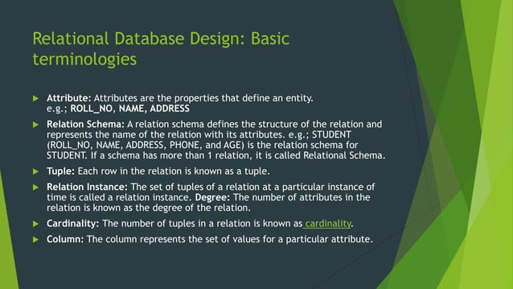

Slide 4
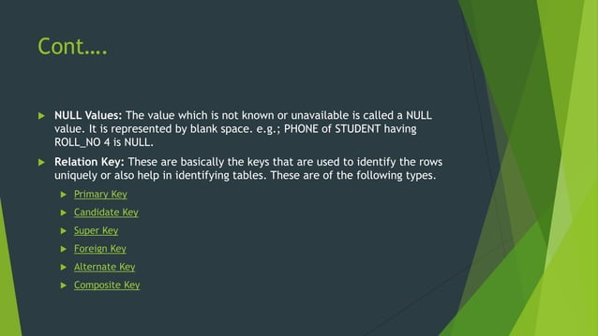

Slide 5
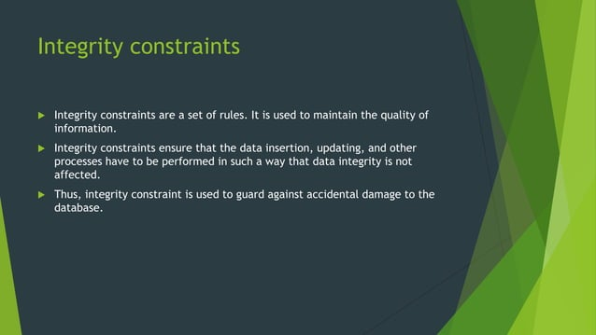

Slide 6
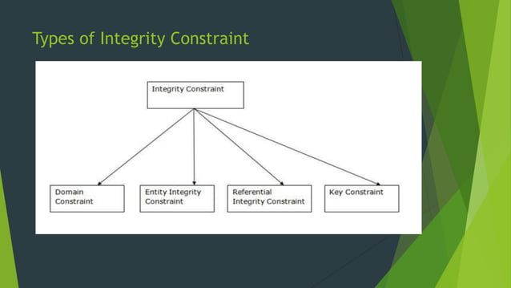

Slide 7
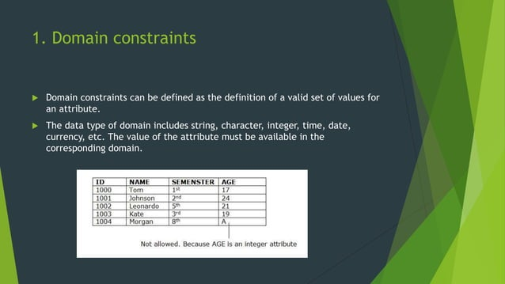

Slide 8
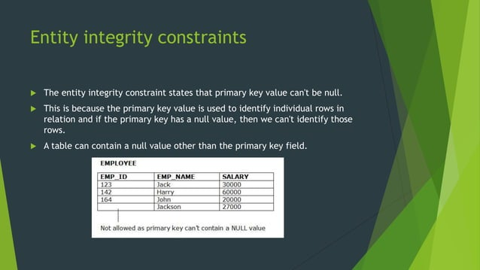

Slide 9
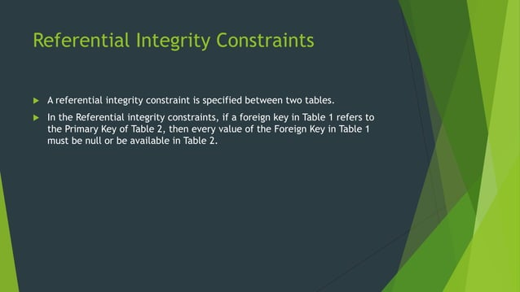

Slide 10
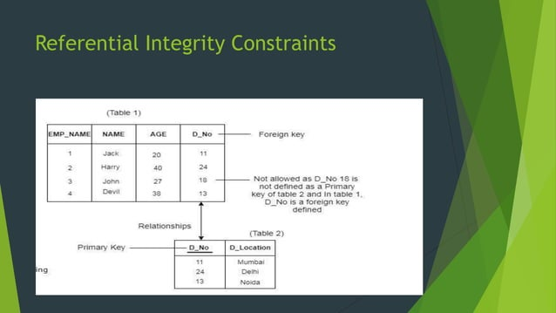

Slide 11
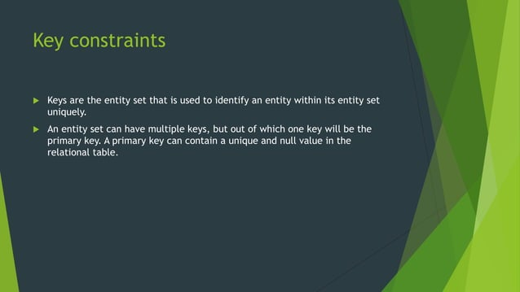

Slide 12
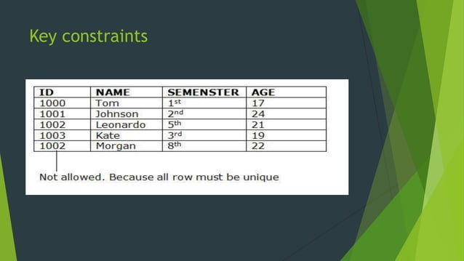

Slide 13
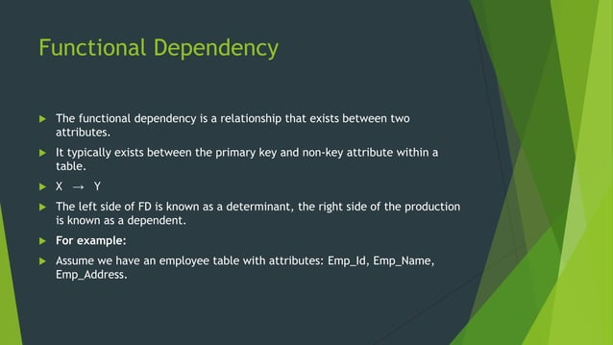

Slide 14
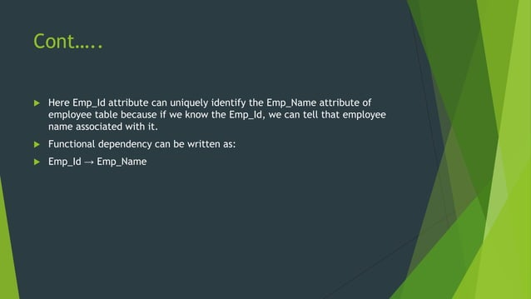

Slide 15
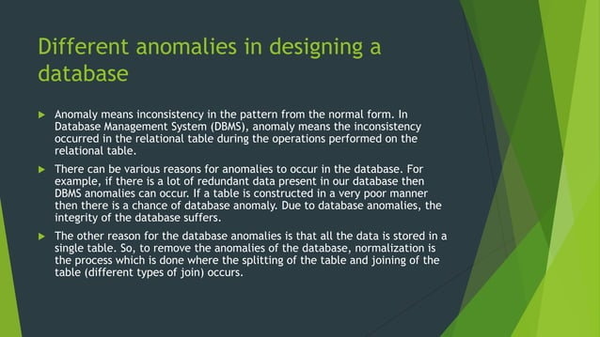

Slide 16


Slide 17
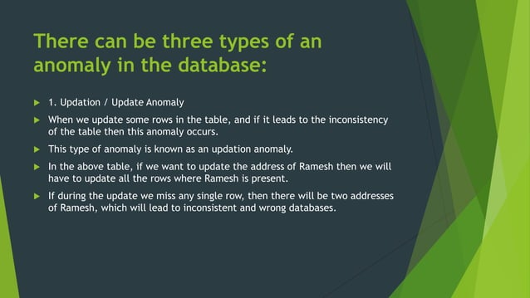

Slide 18
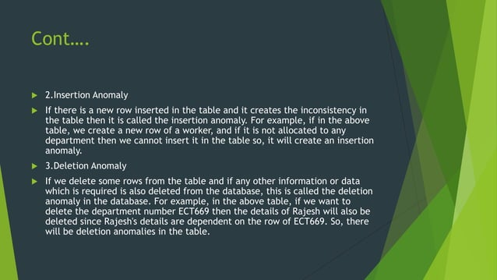

Slide 19
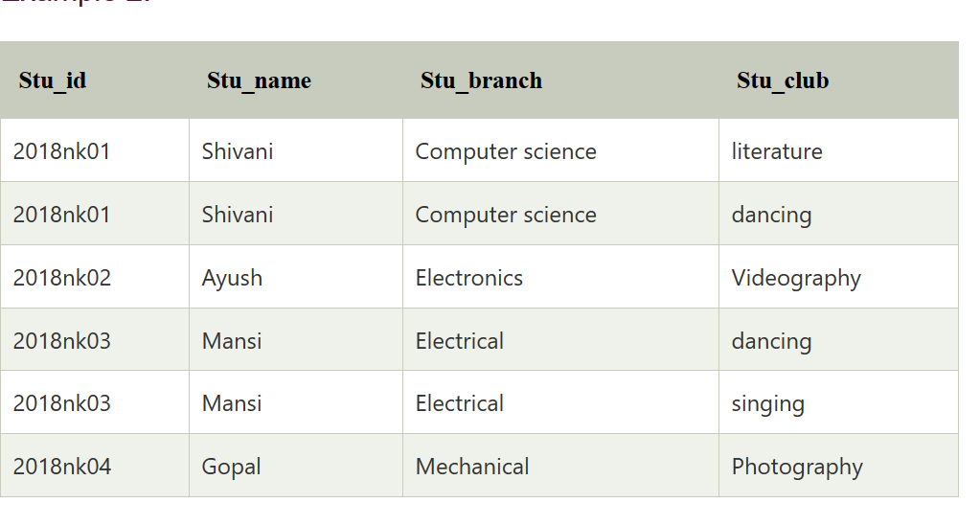
Updation / Update Anomaly
In the above table, if Shivani changes her branch from Computer Science to Electronics, then we will have to update all the rows. If we miss any row, then Shivani will have more than one branch, which will create the update anomaly in the table.
Insertion Anomaly
If we add a new row for student Ankit who is not a part of any club, we cannot insert the row into the table as we cannot insert null in the column of stu_club. This is called insertion anomaly.
Deletion Anomaly
If we remove the photography club from the college, then we will have to delete its row from the table. But it will also delete the table of Gopal and his details. So, this is called deletion anomaly and it will make the database inconsistent.

Slide 20
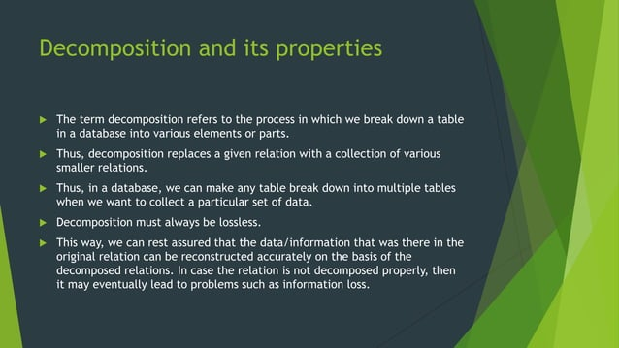

Slide 21
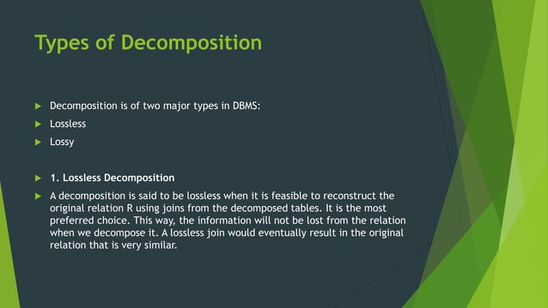

Slide 22
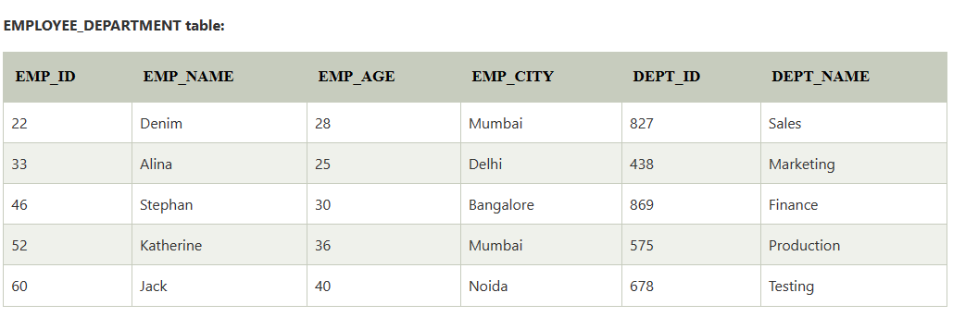
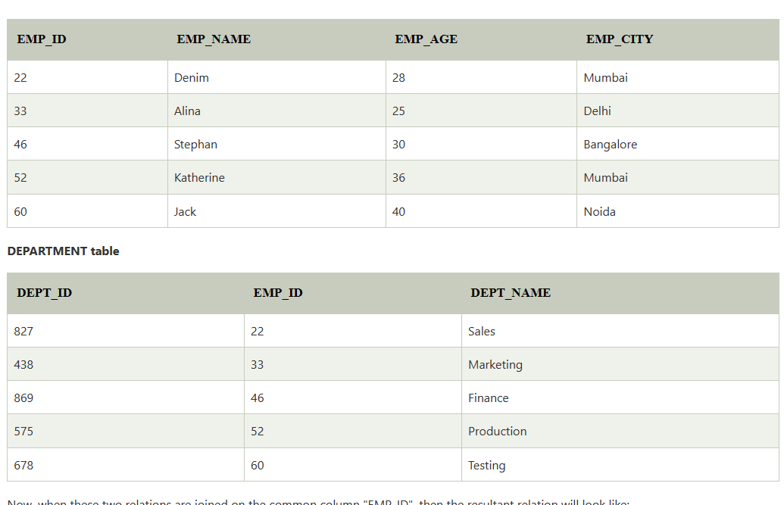
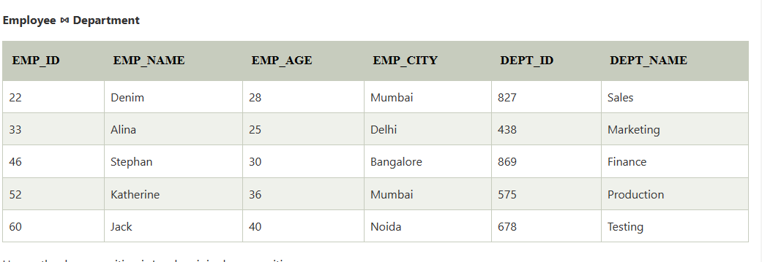

Slide 23
Dependency Preserving
It is an important constraint of the database.
In the dependency preservation, at least one decomposed table must satisfy every dependency.
If a relation R is decomposed into relation R1 and R2, then the dependencies of R either must be a part of R1 or R2 or must be derivable from the combination of functional dependencies of R1 and R2.
For example, suppose there is a relation R (A, B, C, D) with functional dependency set (A->BC). The relational R is decomposed into R1(ABC) and R2(AD) which is dependency preserving because FD A->BC is a part of relation R1(ABC).

Slide 24
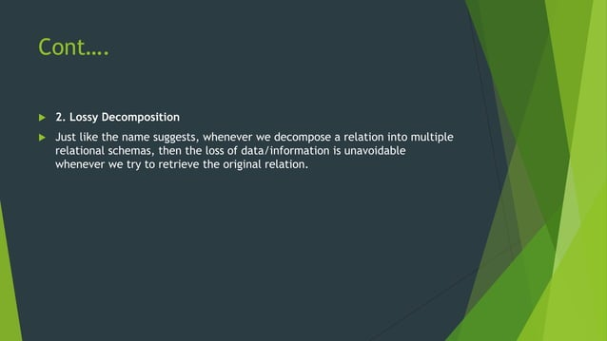

Slide 25
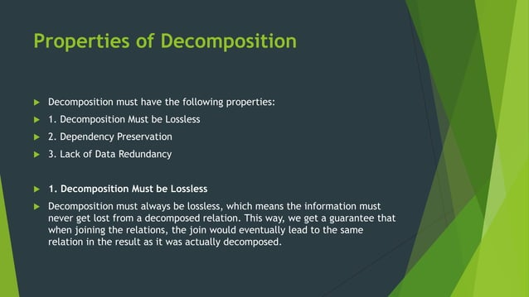

Slide 26
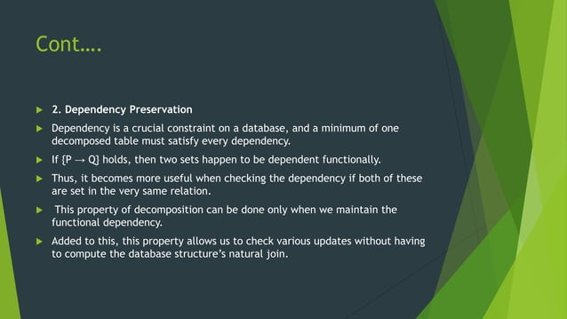

Slide 27
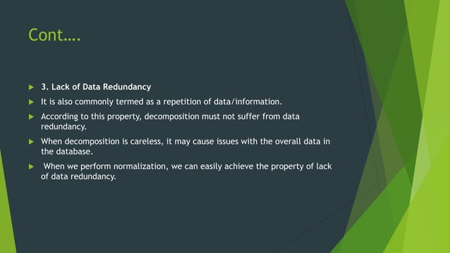

Slide 28
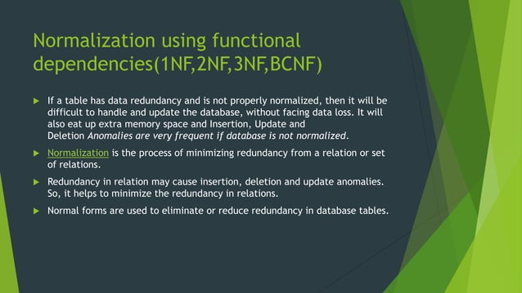

Slide 29
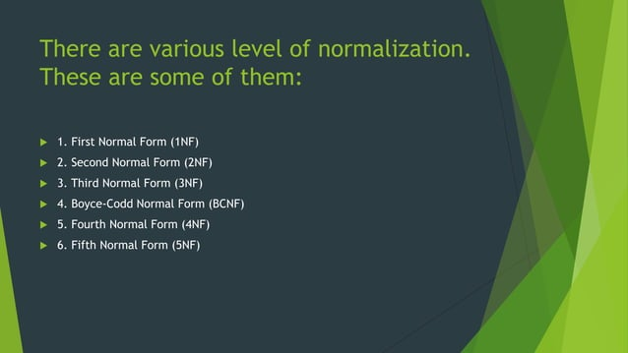

Slide 30
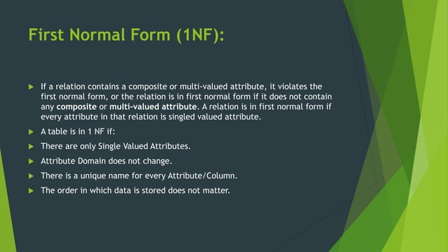

Slide 31
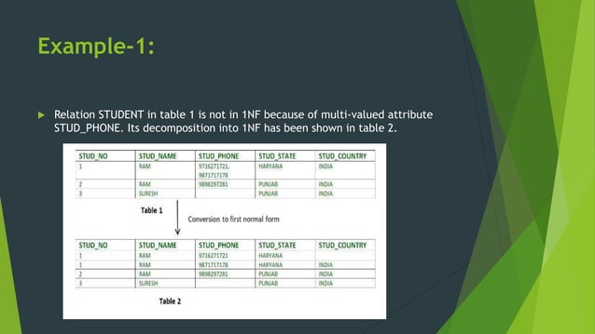

Slide 32
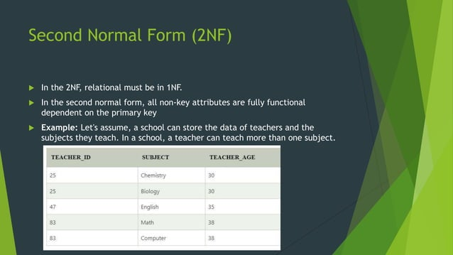

Slide 33


Slide 34
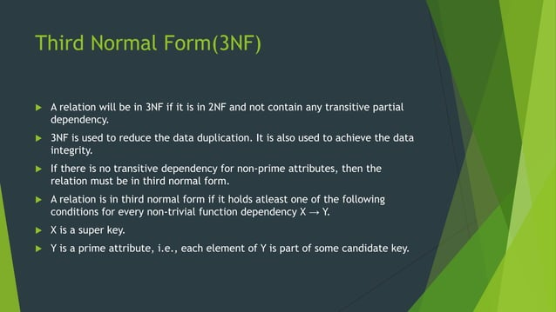

Slide 35
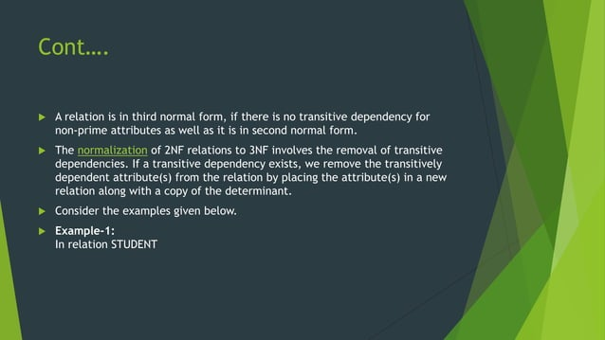

Slide 36
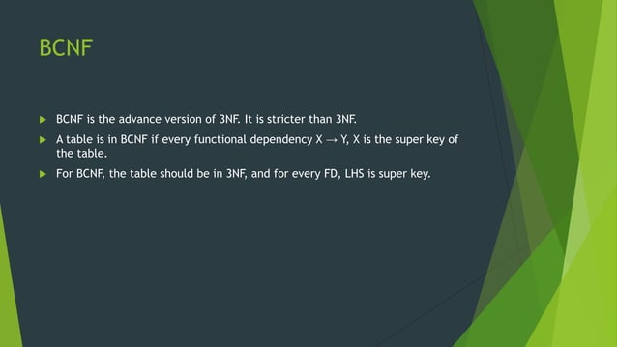

Slide 37
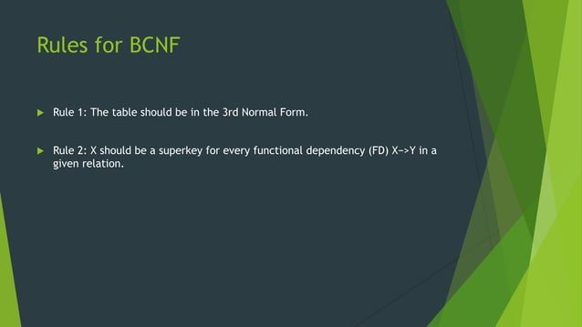

Slide 38
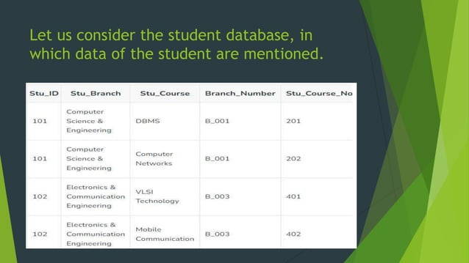

Slide 39
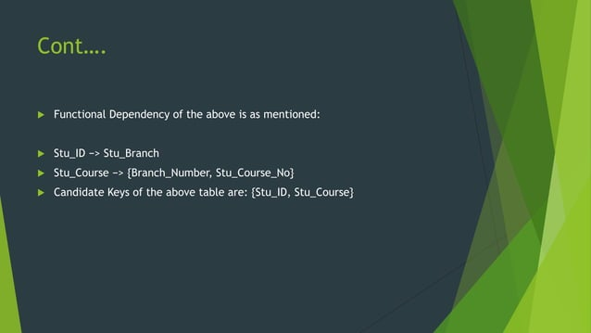

Slide 40
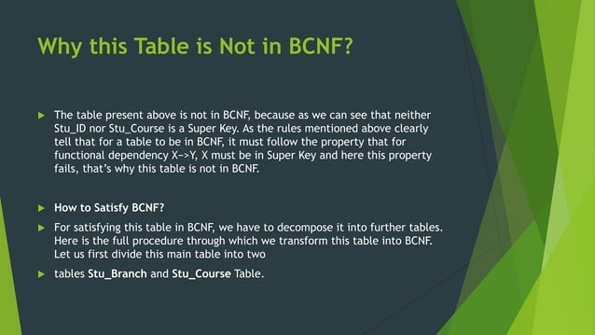

Slide 41


Slide 42


Slide 43
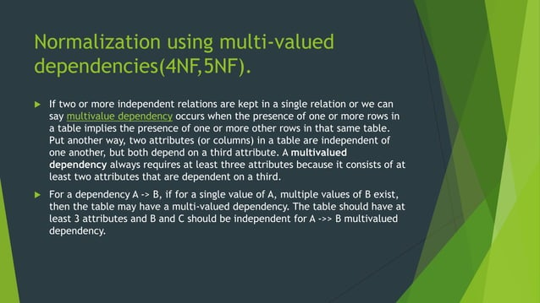

Slide 44
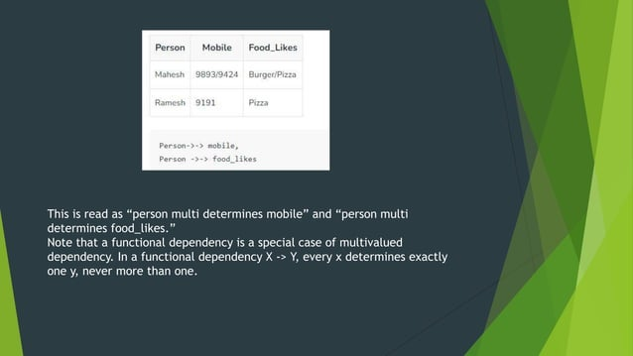

Slide 45
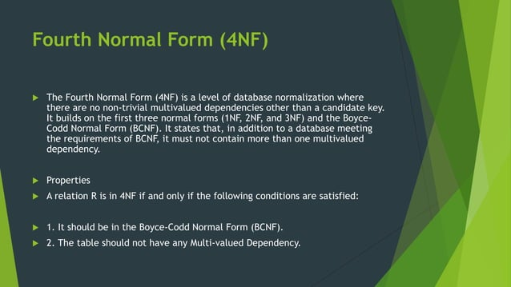

Slide 46
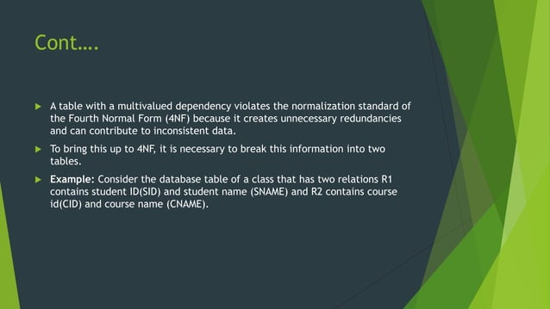

Slide 47
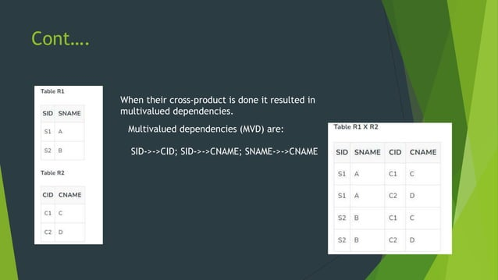

Slide 48
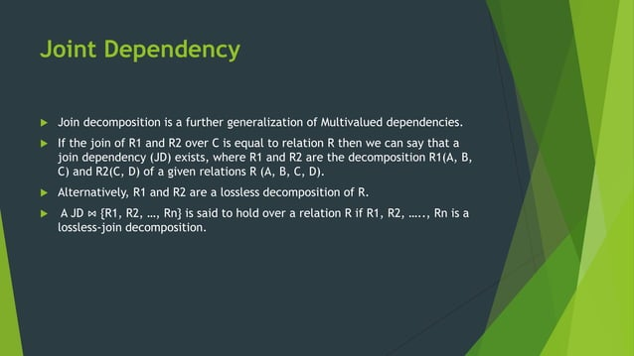

Slide 49
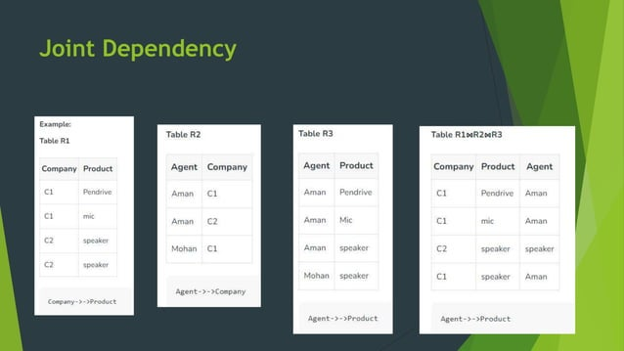

Slide 50
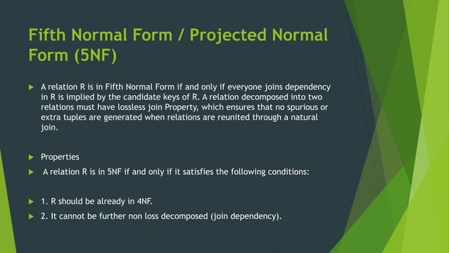

Slide 51
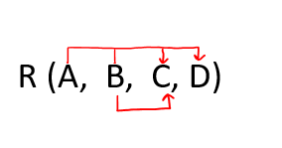
Question on Second Normal Form (2NF):
1. Given a relation R( A, B, C, D) and Functional Dependency set FD = { AB → CD, B → C }, determine whether the given R is in 2NF? If not convert it into 2 NF.
Solution: Let us construct an arrow diagram on R using FD to calculate the candidate key.

Slide 52
From above arrow diagram on R, we can see that an attributes AB is not determined by any of the given FD, hence AB will be the integral part of the Candidate key, i.e. no matter what will be the candidate key, and how many will be the candidate key, but all will have AB compulsory attribute.

Slide 53
Let us calculate the closure of AB
AB + = ABCD
Since the closure of AB contains all the attributes of R, hence AB is Candidate Key
From the definition of Candidate Key(Candidate Key is a Super Key whose no proper subset is a Super key)
Since all key will have AB as an integral part, and we have proved that AB is Candidate Key, Therefore, any superset of AB will be Super Key but not Candidate key.
Hence there will be only one candidate key AB

Slide 54
Definition of 2NF: No non-prime attribute should be partially dependent on Candidate Key
Since R has 4 attributes: - A, B, C, D, and Candidate Key is AB, Therefore, prime attributes (part of candidate key) are A and B while a non-prime attribute are C and D
a) FD: AB → CD satisfies the definition of 2NF, that non-prime attribute(C and D) are fully dependent on candidate key AB
b) FD: B → C does not satisfy the definition of 2NF, as a non-prime attribute(C) is partially dependent on candidate key AB( i.e. key should not be broken at any cost)
As FD B → C, the above table R( A, B, C, D) is not in 2NF
Convert the table R(A, B, C, D) in 2NF:
Since FD: B → C, our table was not in 2NF, let's decompose the table

Slide 55
Since the key is AB, and from FD AB → CD, we can create R2(A, B, C, D) but this will again have a problem of partial dependency B → C, hence R2(A, B, D).
Finally, the decomposed table which is in 2NF
a) R1( B, C)
b) R2(A, B, D)

Slide 56
Question on Third Normal Form (3NF):
Definition 1: A relational schema R is said to be in 3NF, First, it should be in 2NF and, no non-prime attribute should be transitively dependent on the Key of the table.
If X → Y and Y → Z exist then X → Z also exists which is a transitive dependency, and it should not hold.
Definition 2: First it should be in 2NF and if there exists a non-trivial dependency between two sets of attributes X and Y such that X → Y (i.e., Y is not a subset of X) then
Either X is Super Key
Or Y is a prime attribute.

Slide 57
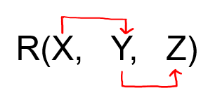
Question 1: Given a relation R( X, Y, Z) and Functional Dependency set FD = { X → Y and Y → Z }, determine whether the given R is in 3NF? If not convert it into 3 NF.
Solution: Let us construct an arrow diagram on R using FD to calculate the candidate key.

Slide 58
From above arrow diagram on R, we can see that an attribute X is not determined by any of the given FD, hence X will be the integral part of the Candidate key, i.e. no matter what will be the candidate key, and how many will be the candidate key, but all will have X compulsory attribute.
Let us calculate the closure of X
X + = XYZ (from the closure method we studied earlier)
Since the closure of X contains all the attributes of R, hence X is Candidate Key

Slide 59
From the definition of Candidate Key (Candidate Key is a Super Key whose no proper subset is a Super key)
Since all key will have X as an integral part, and we have proved that X is Candidate Key, Therefore, any superset of X will be Super Key but not the Candidate key.
Hence there will be only one candidate key X
Definition of 3NF: A relational schema R is said to be in 3NF, First, it should be in 2NF and, no non-prime attribute should be transitively dependent on the Key of the table.
If X → Y and Y → Z exist then X → Z also exists which is a transitive dependency, and it should not hold.
Since R has 3 attributes: - X, Y, Z, and Candidate Key is X, Therefore, prime attribute (part of candidate key) is X while a non-prime attribute are Y and Z
Given FD are X → Y and Y → Z

Slide 60
So, we can write X → Z (which is a transitive dependency)
In above FD X → Z, a non-prime attribute( Z) is transitively depending on the key of the table( X ) hence as per the definition of 3NF it is not in 3 NF, because no non-prime attribute should be transitively dependent on the key of the table.
Now check the above table is in 2 NF.

Slide 61
FD: X → Y is in 2NF ( as Key is not breaking and its Fully functional dependent )
FD: Y → Z is also in 2NF( as it does not violate the definition of 2NF)
Hence above table R( X, Y, Z ) is in 2NF but not in 3NF.
We can also prove the same from Definition 2: First, it should be in 2NF and if there exists a non-trivial dependency between two sets of attributes X and Y such that X → Y (i.e., Y is not a subset of X) then
Either X is Super Key
Or Y is a prime attribute.
Since we have just proved that above table R is in 2 NF. Let's check it for 3NF using definition 2.

Slide 62
FD: X → Y is in 3NF (as X is a super Key)
FD: Y → Z is not in 3NF (as neither Y is Key nor Z is a prime attribute)
Hence because of Y → Z using definition 2 of 3NF, we can say that above table R is not in 3NF.
Convert the table R( X, Y, Z) into 3NF:
Since due to FD: Y → Z, our table was not in 3NF, let's decompose the table
FD: Y → Z was creating issue, hence one table R1(Y, Z)
Create one Table for key X, R2(X, Y), since X → Y
Hence decomposed tables which are in 3NF are:
R1(X, Y)
R2(Y, Z)

